Slide 1

Software requirements (swr302)
Requirements for specific project classes (chapter 20-26)

Slide 2
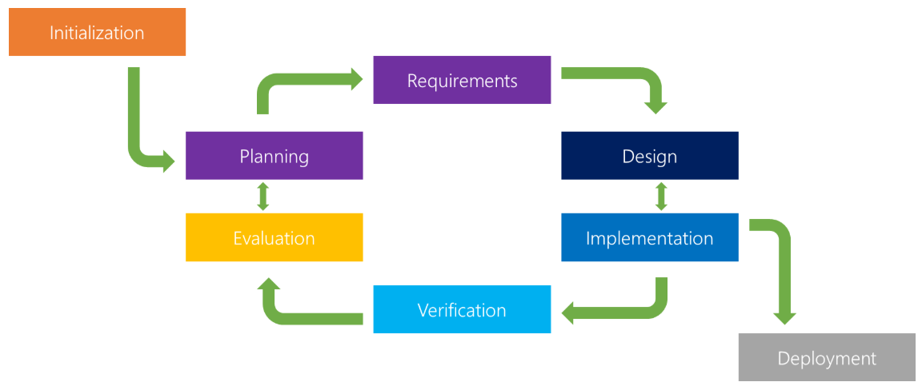
Agile Projects Iterative & Incremental Model
Previous Models
Waterfall
Spiral,
Iterative
Incremental
Rational Unified Process (RUP)

Slide 3
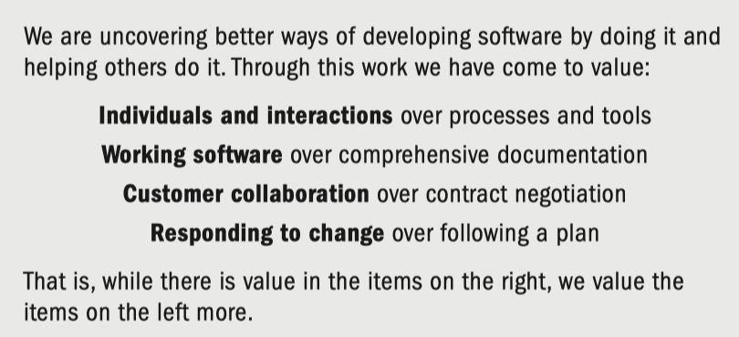
Agile Projects What is Agile?
Thought leaders in the software industry formalized the agile movement in 2001 with the publication of the Manifesto for Agile Software Development
Agile software development refers to software development methodologies centered round the idea of iterative development, where requirements and solutions evolve through collaboration between self-organizing cross-functional teams.

Slide 4
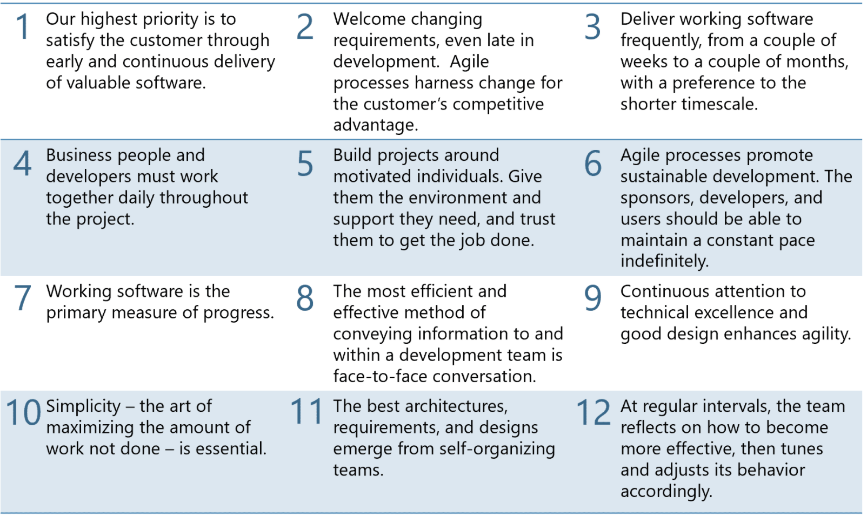
Agile Projects What is Agile?

Slide 5
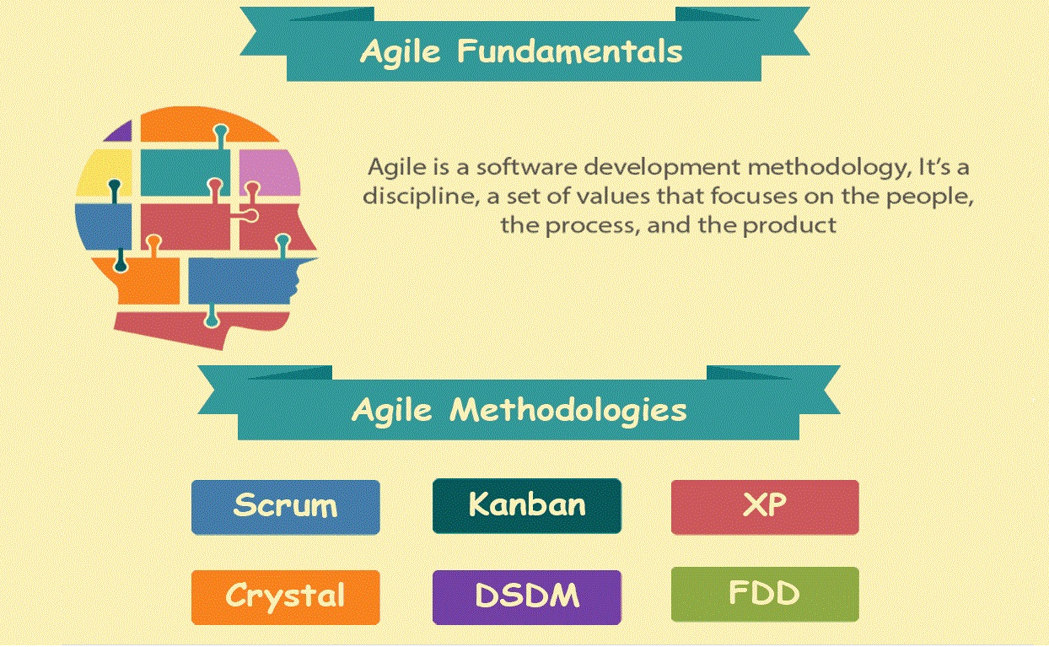
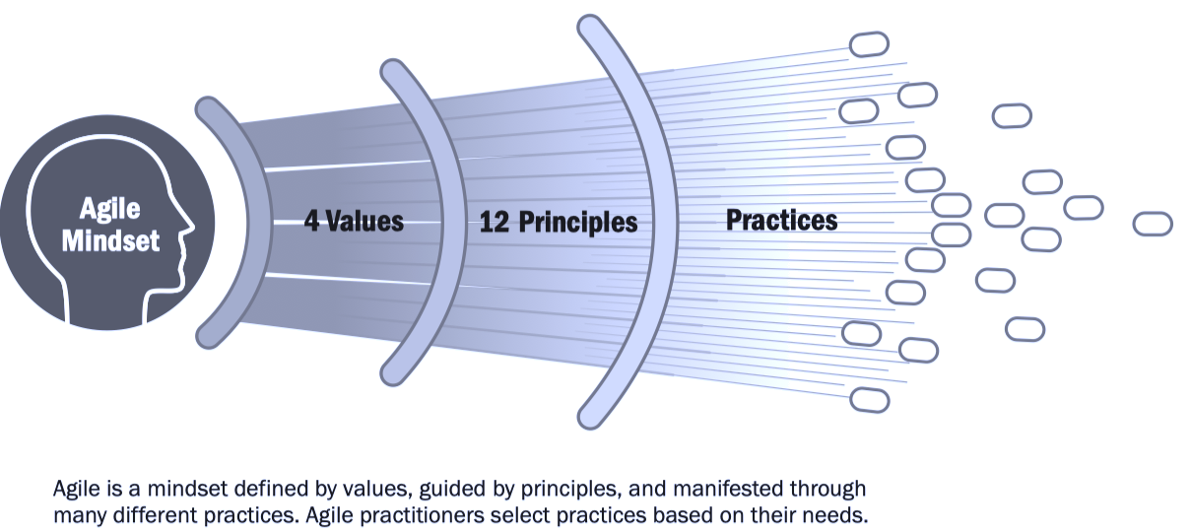

Agile Projects What is Agile?
Notes:
Agile is a software development methodology. It’s a discipline, a set of values that focuses on the people, the process, and the product
The ultimate value in Agile development is that it enables teams to deliver value faster, with greater quality and predictability, and greater aptitude to respond to change.

Slide 6
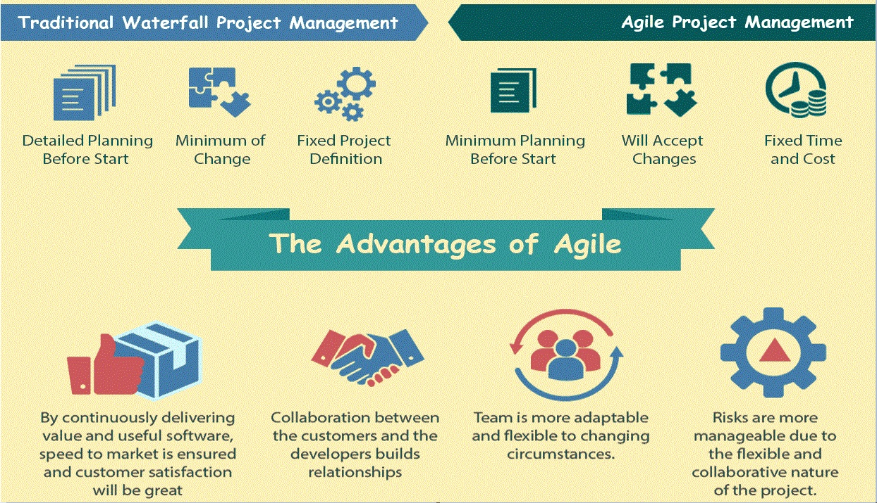
Agile Projects Agile vs. Waterfall

Slide 7
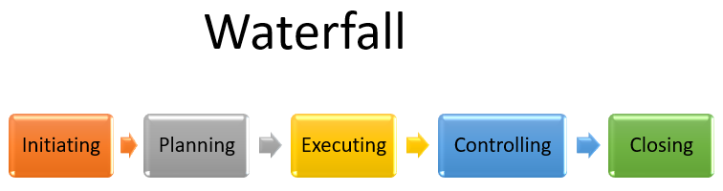
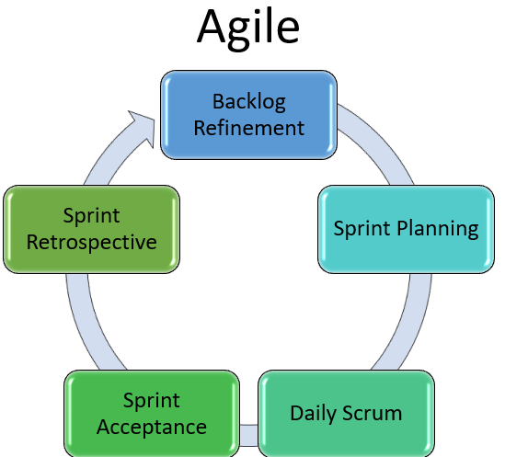
Agile Projects Agile vs. Waterfall
Project lifecycle
Predictive: traditional
Adaptive: agile, iterative or incremental
Hybrid: a combination of a predictive and an adaptive life cycle

Slide 8
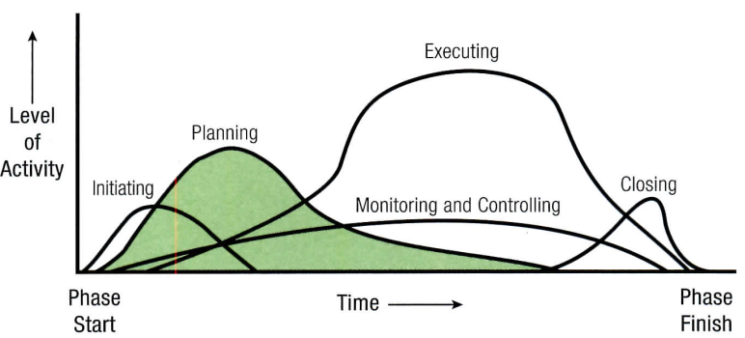
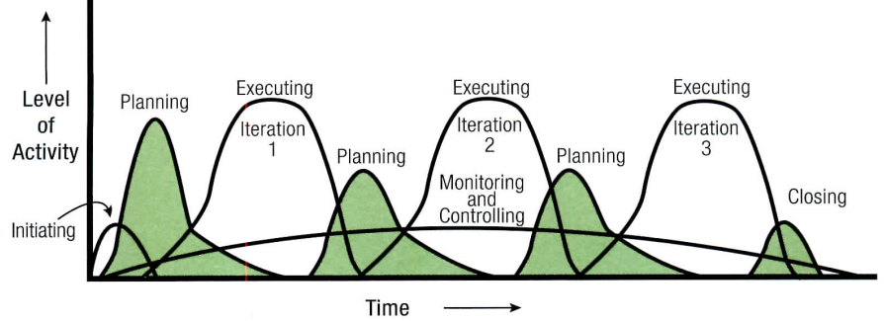
Agile Projects Agile vs. Waterfall
Planning Effort Over Project Life Cycle
Non Agile Project
Agile Project

Slide 9
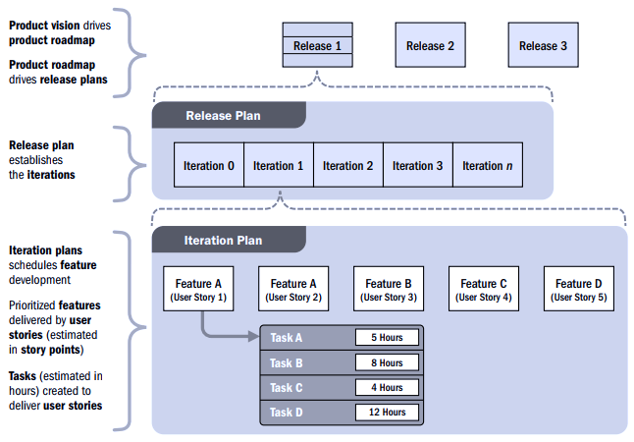
Agile Projects Agile Release Planning

Slide 10
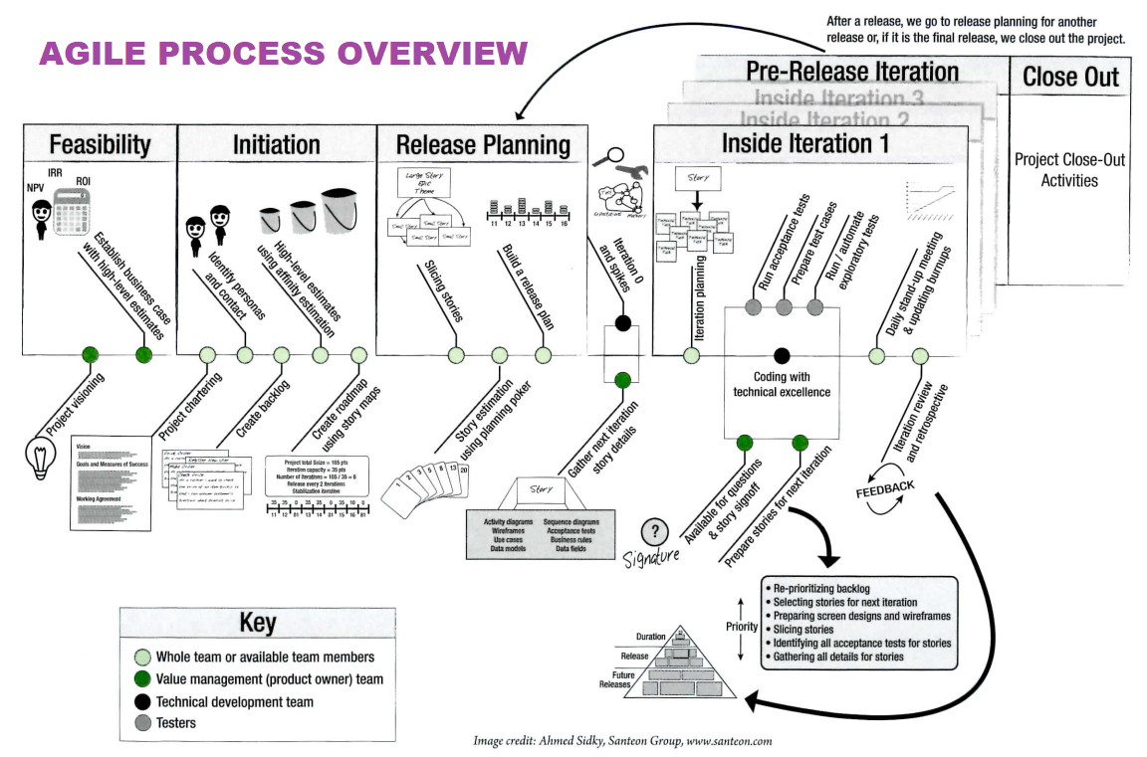
Agile Projects Agile Project Management Process

Slide 11
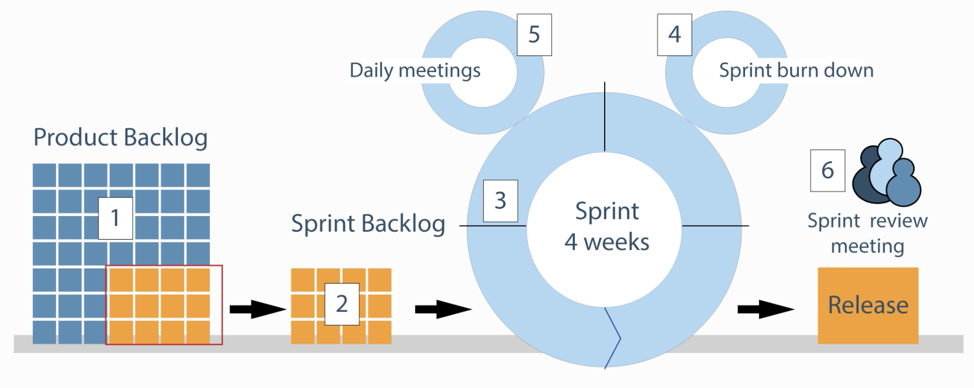
Agile Projects Scrum Framework
Scrum Events
Sprint
Sprint Planning
Daily Scrum
Sprint Review
Sprint Retrospective
Scrum Team
Product Owner
Development Team
Self orgarnize
Cross functional
Scrum Master
Artifacts
Product Backlog
Sprint Backlog
Increment

Slide 12
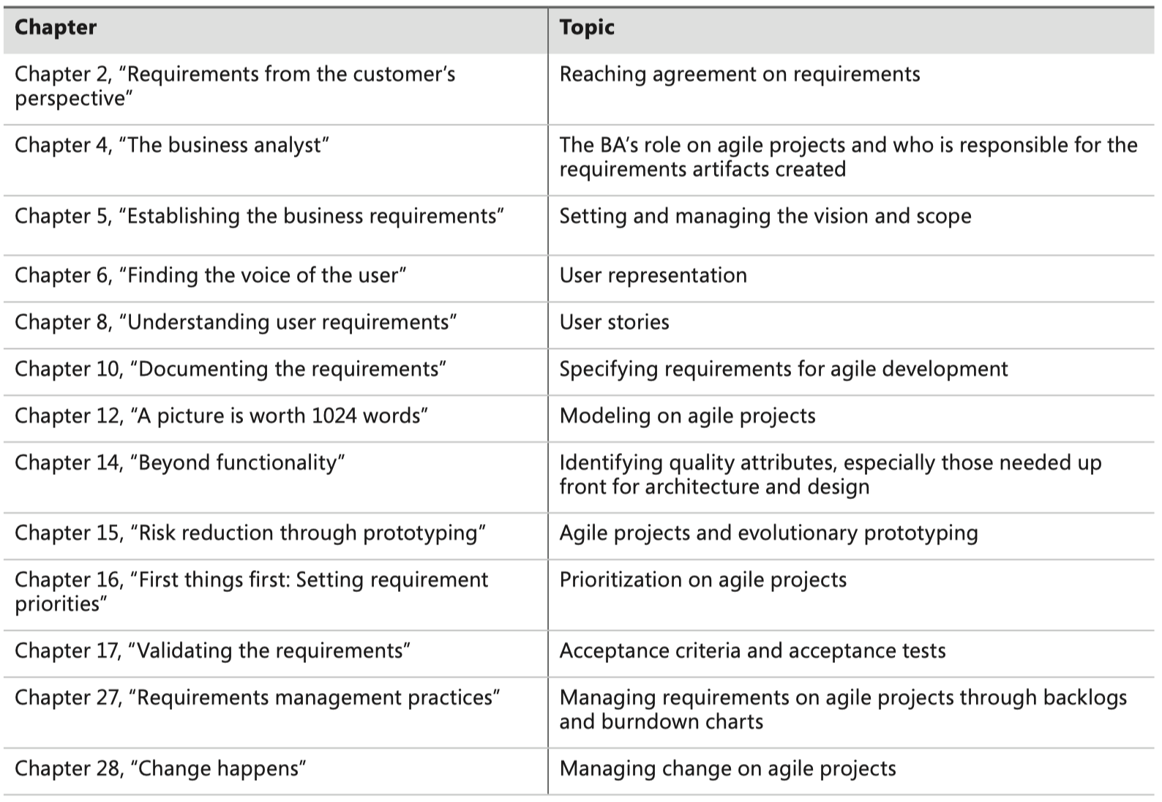
Agile Projects Adapting requirements practices

Slide 13
Agile Projects Transitioning to Agile: Now what?
Determine what your role is on the team
Read to understand user stories, acceptance tests, backlog prioritization, and why the agile BA is never “finished” until the end of the project or release.
Identify suggested agile practices that will work best in your organization
Implement a small project first as a pilot for agile methods, or implement only a few agile practices on your next project
Implement a hybrid model: choose low-risk practices, bring in a experienced coach for three or four iterations
Don’t be an agile purist just for the sake of being a purist
Notes:
Agile Product Management with Scrum (Pichler 2010).
Purist: người theo chủ nghĩa thuần tuý

Slide 14
Enhancement & replacement projects
What is enhancement and replacement project?
What are expected challenges?
Requirements techniques when there is an existing system?
Prioritizing by using business objectives: how?
When old requirements don’t exist
Which requirements should you specify?
Trace Data: how?
How to discover the requirements of an existing system?
Encouraging new system adoption
Why we do this?
What are advantages?
How to do this?
Can we iterate?

Slide 15
Packaged Solution Projects
What is a packaged solution project?
What are requirements for selecting packaged solutions? What do you have to do with each?
What are requirements for implementing packaged solutions?
Configuration requirements
Integration requirements
Extension requirements
Data requirements
Business process changes
What are common challenges with packaged solutions?
Too many candidates
Too many evaluation criteria
Vendor misrepresents package capabilities
Incorrect solution expectations
Users reject the solution

Slide 16
Outsourced Projects
What is outsourced project?
Acquirer-supplier interactions
Change management
Acceptance criteria

Slide 17
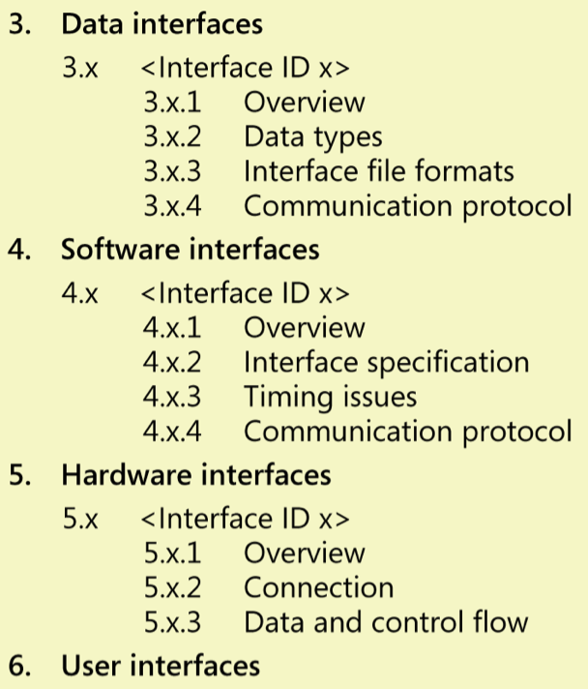
Embedded and other real-time systems projects
System requirements, architecture, and allocation
Modeling real-time systems
Context diagram
State-transition diagram
Event-response table
Architecture diagram
Prototyping
Interfaces
Timing requirements
Execution time
Latency
Predictability
Quality attributes for embedded systems
The challenges of embedded systems

Slide 18
Business process automation projects
What is a business process automation project?
Modeling business processes: how?
Business process acronyms galore
Using current processes to derive requirements
Designing future processes first
What are modeling business performance metrics?
What are good practices for business process automation projects?

Slide 19
Business analytics projects
What is a business analytics project?
How to do the requirements development for business analytics projects?
Prioritizing work by using decisions
Defining how information will be used: by people, in systems
Specifying data needs: big data, data-based requirements: source, storage, management & governance, extraction
Defining analyses that transform the data
What is the evolutionary nature of analytics?

Slide 20


